Slide 1
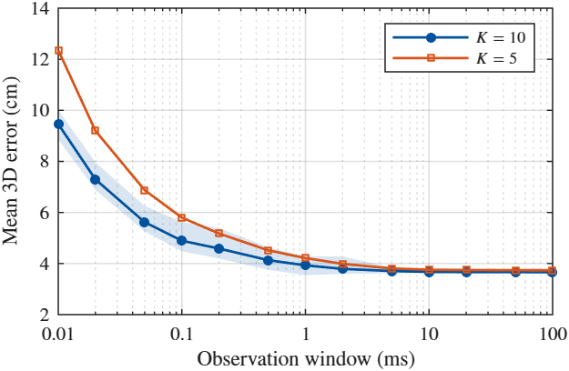
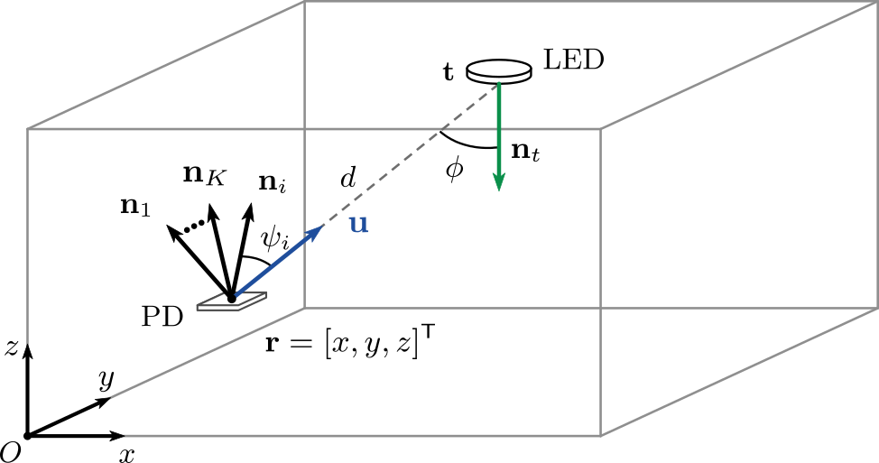
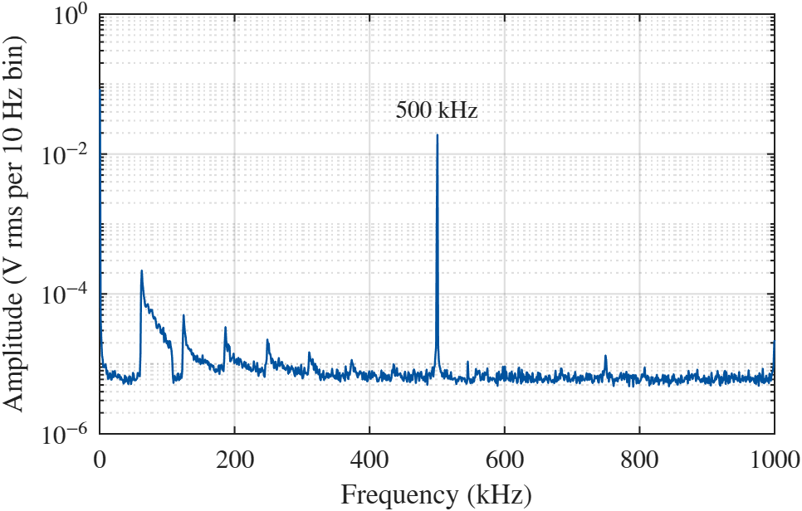
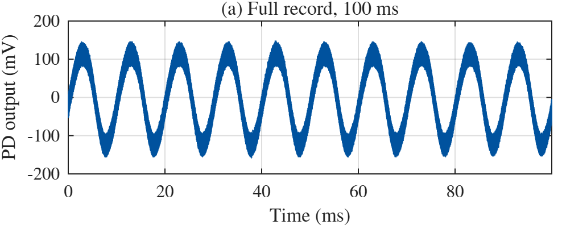
VLP
Observation window

Slide 2
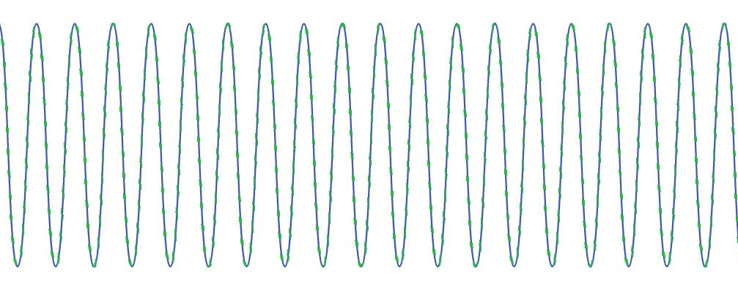
VLP
5ms
995ms
DATA TRANSMISSION
(Communication)
POSITIONING PILOT
500 kHz

Slide 3
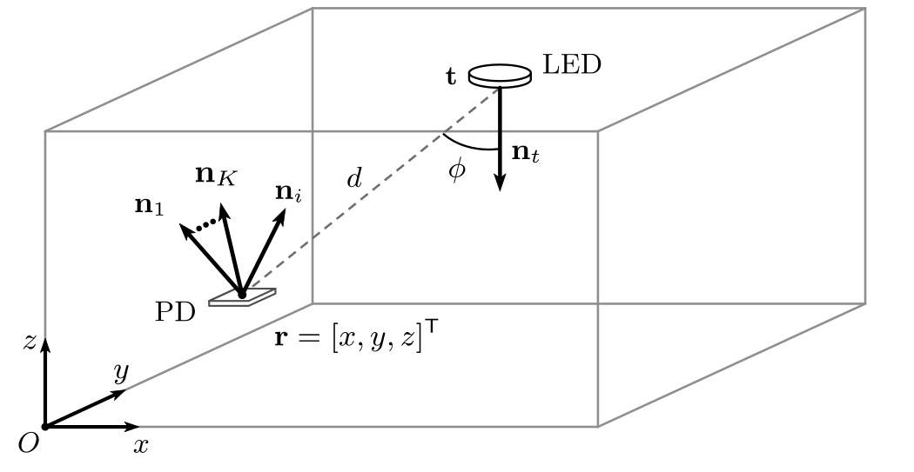
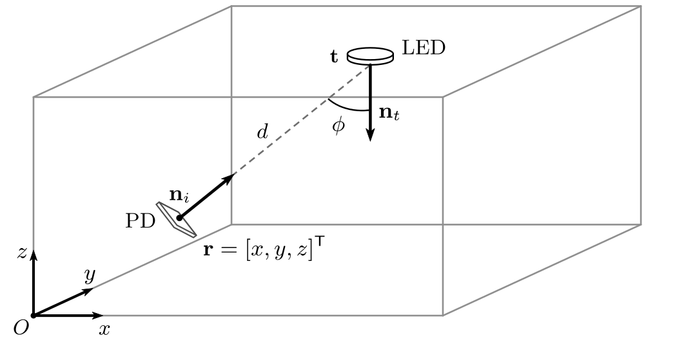
O-ISAC
1
OWP
2
OWC

Slide 4
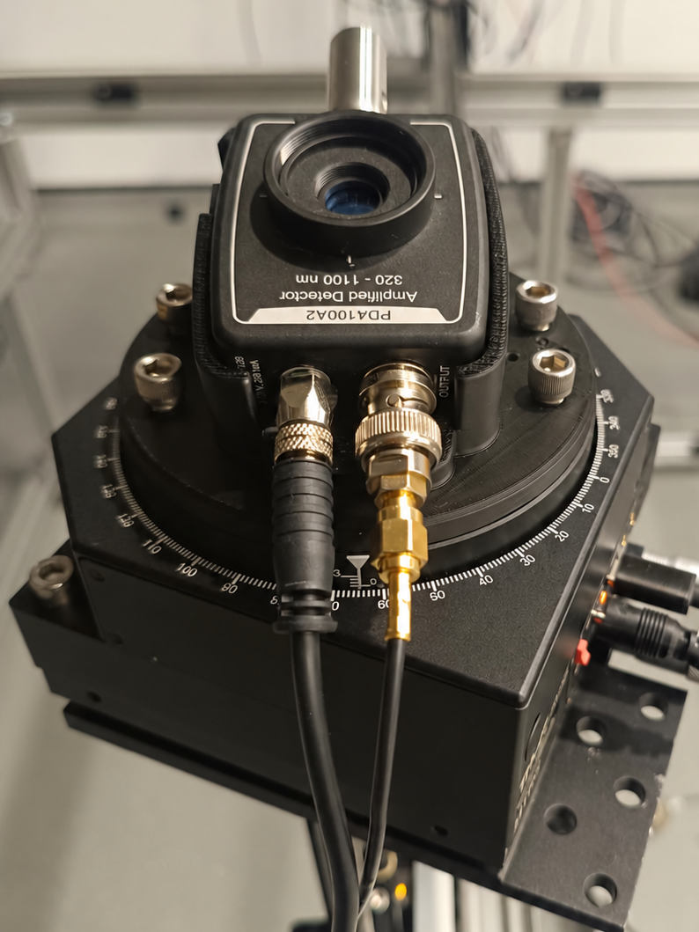
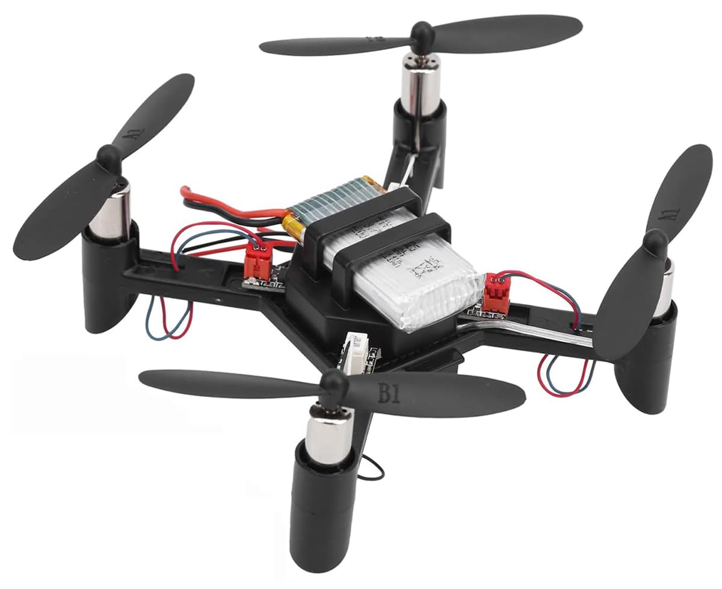
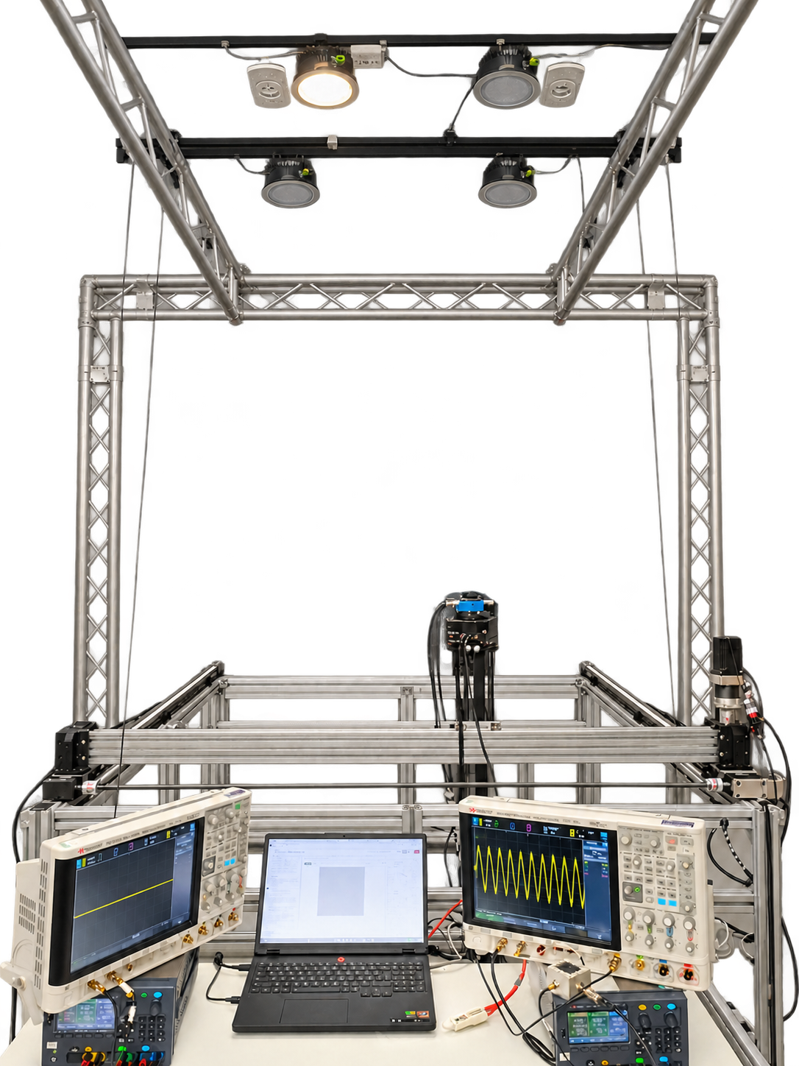
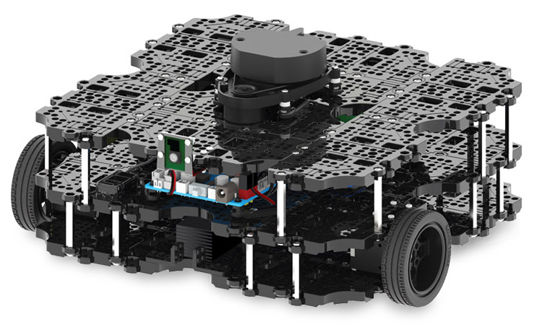
TOWARDS MOBILE RECEIVERS
Different requirements
OUTPUT(0-5V)
POWER SUPPLY
(+/- 12V DC)
OSCILLOSCOPE
(ADC)
LAPTOP
(FFT+ESTIMATION)

Slide 5
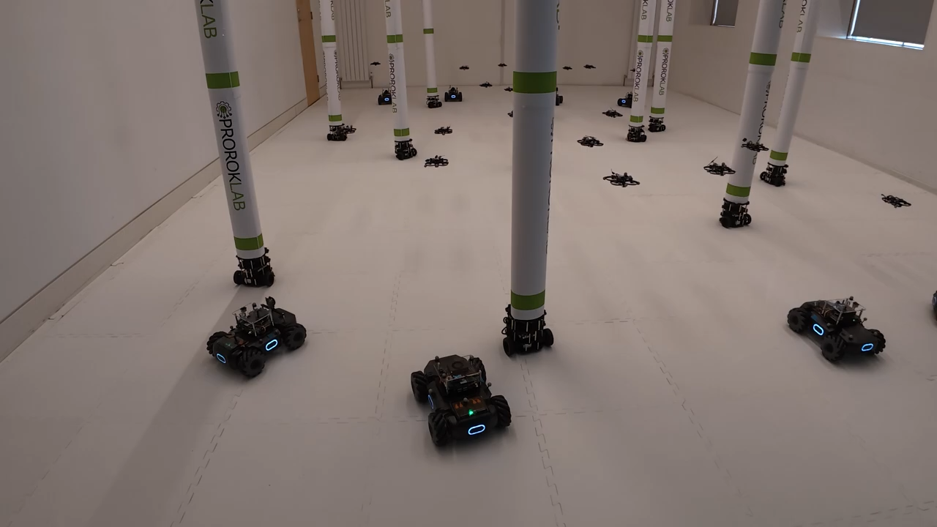
USE CASE OWP in multi-robot systems
PROROKLAB, Department of Computer Science and Technology, University of Cambridge

